Slide 1
Vision 2019

Slide 2
Luke 19:1-10
Jesus entered Jericho and made his way through the town. 2There was a man there named Zacchaeus. He was the chief tax collector in the region, and he had become very rich. 3He tried to get a look at Jesus, but he was too short to see over the crowd. 4So he ran ahead and climbed a sycamore-fig tree beside the road, for Jesus was going to pass that way.
5When Jesus came by, he looked up at Zacchaeus and called him by name. “Zacchaeus!” he said. “Quick, come down! I must be a guest in your home today.”

Slide 3
6Zacchaeus quickly climbed down and took Jesus to his house in great excitement and joy. 7But the people were displeased. “He has gone to be the guest of a notorious sinner,” they grumbled.
8Meanwhile, Zacchaeus stood before the Lord and said, “I will give half my wealth to the poor, Lord, and if I have cheated people on their taxes, I will give them back four times as much!”
9Jesus responded, “Salvation has come to this home today, for this man has shown himself to be a true son of Abraham. 10For the Son of Man came to seek and save those who are lost.” Luke 19:1-10

Slide 4
The last two weeks we have heard 2 things loud and clear from the story of Zacchaeus:
Our name is The Sycamore Church. The Sycamore tree lifted Zacchaeus up so that he could see Jesus. Hence, our motto: “Lifting people up so that they can see Jesus.”
2) Our purpose is “Knowing Him and making Him known.” Zacchaeus came to know Jesus, Jesus changed his life and then He made Jesus known to others through his repayment plan.

Slide 5
Key Question
So, let’s return to the beginning of the story. What happened that started all these things?
Zacchaeus heard God’s voice!
Audrey and I heard God’s voice in 1992
Many times since then we have heard God’s voice
Now, we have heard God’s voice again
“Get back to the HUB!”

Slide 6
Two Questions
1) What is a HUB?
a) It is where you begin
b) It is home base
c) It is the place from which you are sent out – just like spokes on a wheel

Slide 7
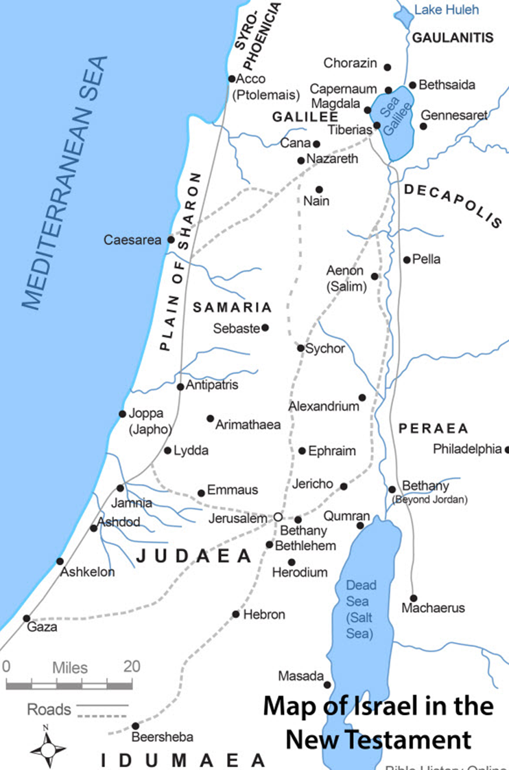

Slide 8
Acts 1:8
But you will receive power when the Holy Spirit comes upon you. And you will be my witnesses, telling people about me everywhere—in Jerusalem, throughout Judea, in Samaria, and to the ends of the earth.”
2) What is our HUB?
a) We began in Georgetown
b) Our office and home base has always been there
c) We have sent out many from this place

Slide 9
What will this require?
1) A re-launch of The Sycamore Church in Georgetown
2) A renewal and revival of us as a people
3) An ALL-IN commitment to Jesus and this body
4) A centering of our lives on HIS purpose – KHMHK
5) Hearing His voice

Slide 10
So, what time is it for The Sycamore Church??
I give you four New Testament words that will give you the exact time:
1) Chronos
2) Eon
3) Telos
4) Kairos
There is no plan B!

