Slide 1
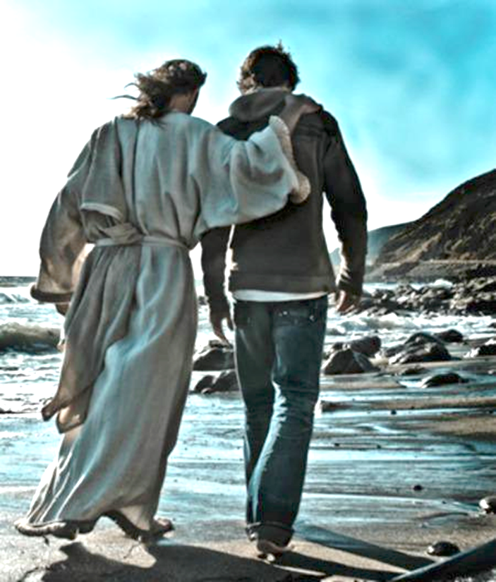
Or following
Jesus
Just taking
a walk…

Slide 2
Bible Engagement: Why be in love with God’s Word?
¹² For the word of God is alive and powerful. It is sharper than the sharpest two-edged sword, cutting between soul and spirit, between joint and marrow. It exposes our innermost thoughts and desires. Hebrews 4:12 NLT

Slide 3
Bible Engagement: Why be in love with God’s Word?
1. So, He can reveal His character.
7 Dear friends, let us love one another, for love comes from God. Everyone who loves has been born of God and knows God. 8 Whoever does not love does not know God, because God is love. 9 This is how God showed his love among us: He sent his one and only Son into the world that we might live through him. 10 This is love: not that we loved God, but that he loved us and sent his Son as an atoning sacrifice for our sins 1 John 4:7-10 NIV

Slide 4
Bible Engagement: Why be in love with God’s Word?
2. To understand our identity through an imitate relationship with God.
1 Follow God’s example, therefore, as dearly loved children Ephesians 5:1 NIV

Slide 5
Bible Engagement: Why be in love with God’s Word?
3.To be filled with His word which helps us with sin.
I have hidden your word in my heart that I might not sin against you. Psalm 119:11 NIV
4. For guidance in our daily lives.
Your word is a lamp to my feet, and a light on my path. Psalm 119:105 NIV

Slide 6
Bible Engagement: Why be in love with God’s Word?
5. To come to the realization of the battle that surrounds us and how to fight it.
12 For we do not wrestle against flesh and blood, but against the rulers, against the authorities, against the cosmic powers over this present darkness, against the spiritual forces of evil in the heavenly places. 13 Therefore take up the whole armor of God, that you may be able to withstand in the evil day, and having done all, to stand firm. Ephesians 6:12-13 ESV
He will be a spirit of justice to the one who sits in judgment, a source of strength to those who turn back the battle at the gate. Isaiah 28:6 NIV

Slide 7
Bible Engagement: Why be in love with God’s Word?
6. To renew our minds and know God’s will.
Therefore, I urge you, brothers and sisters, in view of God’s mercy, to offer your bodies as a living sacrifice, holy and pleasing to God—this is your true and proper worship. 2 Do not conform to the pattern of this world, but be transformed by the renewing of your mind. Then you will be able to test and approve what God’s will is—his good, pleasing and perfect will.
^{Romans 12:1-2 NIV}

Slide 8
Bible Engagement: Why be in love with God’s Word?
7. For courage to change our culture, by accepting you have been sent.
8 Keep this Book of the Law always on your lips; meditate on it day and night, so that you may be careful to do everything written in it. Then you will be prosperous and successful. 9 Have I not commanded you? Be strong and courageous. Do not be afraid; do not be discouraged, for the Lord your God will be with you wherever you go.” Joshua 1:8-9 NIV

Slide 9
Bible Engagement: Why be in love with God’s Word?
^{How to engage God’s word?}
1.Come before Him with a repentant heart.
2.Come before Him with a humble heart.
3.Come before Him with a hungry heart.
4.Come before Him with the attitude of gratefulness.
5.Make a commitment to Him to spend time in His word.
6.Allow yourself to be held accountable to this commitment.
What commitment to God and His word are you willing to be held accountable, starting today?

